Slide 1

Loan Status Prediction
Team Name: Group 4
Team members:
Adarsh Shekar
Shruti Manwatkar
Deviprasad Shetty
Darshana Yenkar
Sushil Suman
Mentor Name:
Parth
Kavipriya
Date : 5 March 2021

Slide 2
Business Problem:
It’s not at all easy to get a loan from the bank. Getting a loan approved requires a complex mix of factors and not sure if all the customers can pay off the loan.
Objective:
The objective of the analysis is to predict if customer is eligible for getting the loan.

Slide 3
Project Architecture / Project Flow
Understanding the problem
Data Preparation / Exploration
Modelling
Evaluation
Deployment

Slide 4
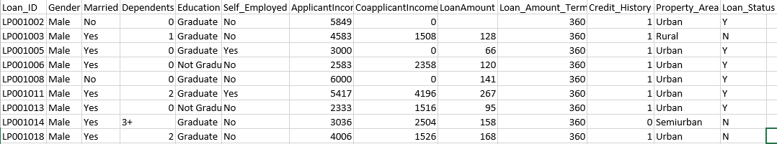
Data set details
Train Dataset:
Training data set details​:
Total Rows = 614
Total columns = 13​
Columns:​
'Loan_ID', 'Gender', 'Married', 'Dependents', 'Education', 'Self_Employed', 'ApplicantIncome', 'CoapplicantIncome', 'LoanAmount', 'Loan_Amount_Term', 'Credit_History', 'Property_Area', 'Loan_Status'

Slide 5
Data set details
Missing values :
Gender=13, Married=3, Dependents=15, Self_Employed=32, LoanAmount=22, Loan_Amount_Term=14, Credit_History=50
Test data set details:
Total Rows=367
Total columns=12
Columns:
'Loan_ID','Gender','Married','Dependents','Education','Self_Employed','ApplicantIncome','CoapplicantIncome', 'LoanAmount', 'Loan_Amount_Term', 'Credit_History', 'Property_Area'
Missing values:
Gender=11,Dependents=10, Self_Employed=23, LoanAmount=5, Loan_Amount_Term=6, Credit_History = 29
Unique values:
Gender: ['Male' 'Female' nan], Married: ['No' 'Yes' nan], Dependents: ['0' '1' '2' '3+' nan], Education: ['Graduate' 'Not Graduate’], Self_Employed: ['No' 'Yes' nan], Credit_History: [ 1. 0. nan], Property_Area: ['Urban' 'Rural' 'Semiurban’], Loan_Status: ['Y' 'N']

Slide 6
Data set details
We have 12 independent variables and 1 target variable I.e loan status
There are three formats of data types:
Object : Object format means variables are categorical. Categorical variables in our dataset are: loan_ID, Gender, Married, Dependents, Education, Self_Employed, Property_Area, Loan_Status.
Int64 : It represents the integer variables. ApplicantIncome is of this format.
Float64 : It represents the variable which have some decimal values involved. They are also numerical.
Missing value imputation:
There are missing values in Gender, Married, Dependents, Self-employed, Loan amount, Loan amount term, and Credit history features.
For numerical variables: imputation using mean or median
For categorical variables: imputation using mode

Slide 7
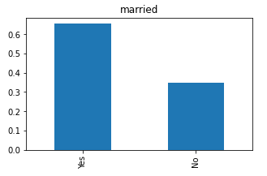
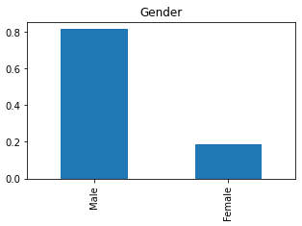
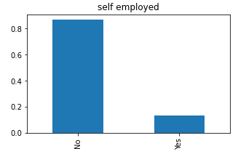
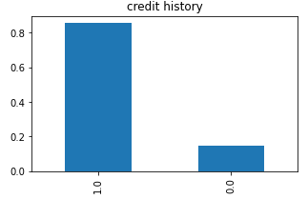
Exploratory Data Analysis (EDA)
Univariate Analysis:-
From the above graphs, it can be inferred that:
80% of applicants in the dataset are male
Around 65% of the applicants in the dataset are married.
Around 15% of applicants in the dataset are self-employed.
Around 85% of applicants have repaid their doubts

Slide 8
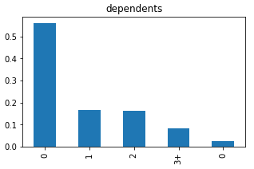
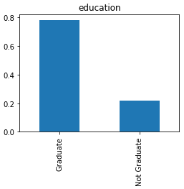
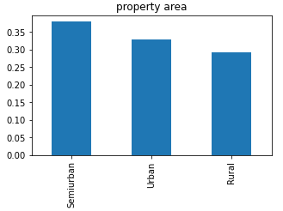
EDA -Univariate Analysis
From the above graphs, it can be inferred that:
Around 80% of the applicants are Graduate.
Most of the applicants are from the Semiurban area.
most of the applicants don’t have any dependents.

Slide 9
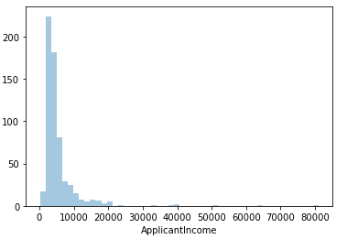
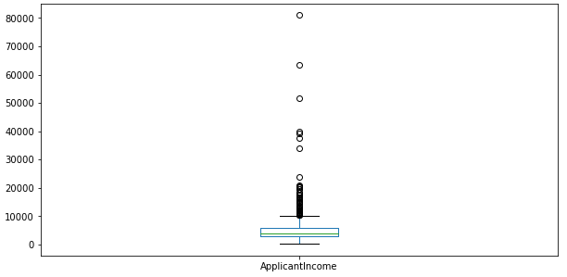
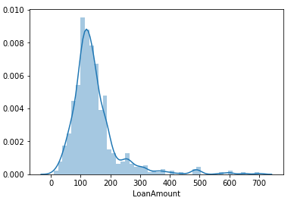
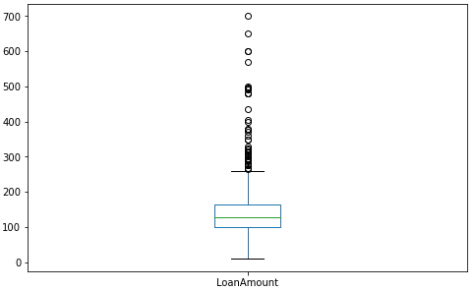
EDA -Univariate Analysis
From the above graphs , it can be inferred that:
The distribution of Applicant income is right skewed and it is not normally distributed. The boxplot confirms the presence of a lot of outliers.
The distribution of loan amount is fairly normal and the boxplot confirms the presence of a lot of outliers.

Slide 10
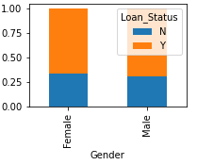
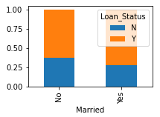
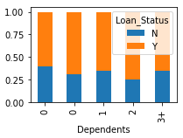
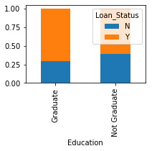
EDA -Bivariate Analysis
From the above graphs , it can be inferred that:
Gender vs loan status: The proportion of male and female applicants is more or less the same for both approved and unapproved loans.
Married vs loan status: The proportion of married applicants is higher for approved loans.
Dependents vs loan status: Distribution of applicants with 1 or 3+ dependents is similar across both the categories of Loan status.
Education vs loan status: The proportion of graduate applicants is higher for approved loans.

Slide 11
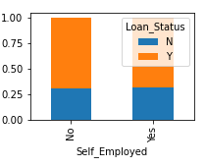
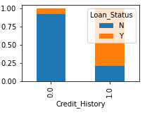
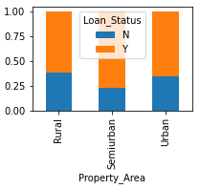
EDA -Bivariate Analysis
From the above graphs, it can be inferred that:
Self-employed vs loan status: There is nothing significant we can infer from Self-employed vs Loan status.
Credit history vs loan status: people with a credit history as 1 are more likely to get their loans approved.
Property area vs loan status: The proportion of loans getting approved in the semi-urban area is higher as compared to that in rural or urban areas.

Slide 12
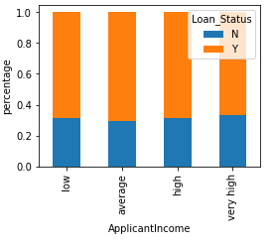
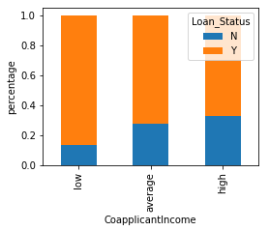
EDA- Bivariate Analysis
From the above graphs, it can be inferred that:
Applicant income vs loan status: The Applicant's income does not affect the chances of loan approval which contradicts our hypothesis I.e if the applicant's income is high the chances of loan approval will also be high.
Co-applicant income vs loan status: if co-applicants income is less the chances of loan approval are high and it does not look right because the most of the applicants don’t have any co-applicant so the co-applicant income for such applicants is 0 and hence the loan approval is not dependent on it.

Slide 13
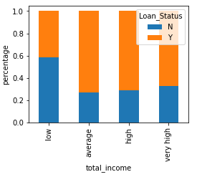
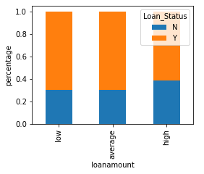
EDA -Bivariate Analysis
From the above graphs, it can be inferred that:
The applicant’s and co-applicants income are combined to visualize the combined effect of income on loan approval.
Total income vs loan status: The Proportion of loans getting approved for applicants having low Total Income is very less compared to that of applicants with Average, High & Very High Income.
Loan amount vs loan status: The proportion of approved loans is higher for Low and Average Loan Amount as compared to that of High Loan Amount so that the chances of loan approval will be high when the loan amount is less.

Slide 14
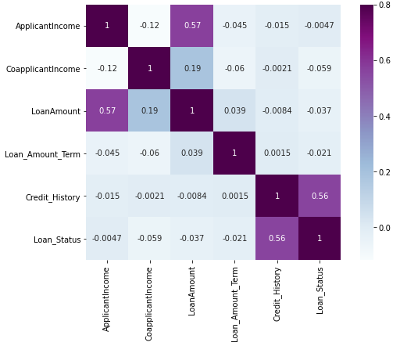
Exploratory Data Analysis (EDA)
The correlation between all the numerical variables are shown below using heat map.
The most correlated variables are Applicant Income-Loan amount, Credit History-Loan status and loan amount - Co-applicant Income.

Slide 15
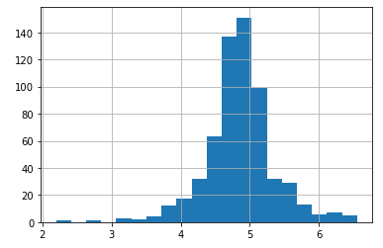
Outliers treatment:
In univariate analysis, we saw that Loan amount, Applicant income and Co-applicant income contains outliers so we have to treat them as the presence of outliers affects the distribution of the data.
One way to remove the skewness is by doing the log transformation. The log transformation does not affect the smaller values much but reduces the larger values. So, we get a distribution similar to normal distribution.
The log transformation of the Loan amount is shown below.
Now the distribution looks much closer to normal and the effect of extreme values has been significantly reduced.

Slide 16
Feature Engineering
From Exploratory Data Analysis, We are including the three new features which will affect the target variable (Loan Status).
Total Income : total income is the combination of the Applicant Income and Co-applicant Income. If the total income is high, the chances of loan approval might also be high.
EMI: EMI is the monthly amount to be paid by the applicant to repay the loan. So people who have high EMI’s might find it difficult to pay back the loan. EMI can be calculated by the ratio of the loan amount with respect to the loan amount term.
Balance Income: This is the income left after the EMI has been paid. So if balance income is high, the chances are high that a person will repay the loan and hence increasing the chances of loan approval.

Slide 17
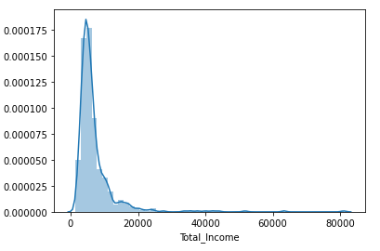
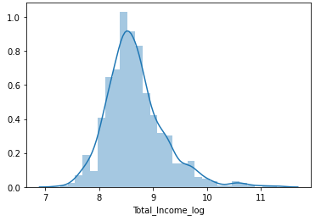
Feature Engineering
The plot of total income and log of total income
From the plot of Total Income we can see the plot is right skewed which appears to be outliers so we take log transformation of total income to make the distribution normal.

Slide 18
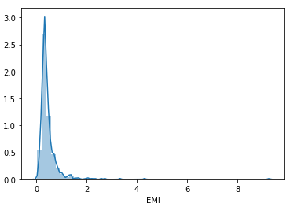
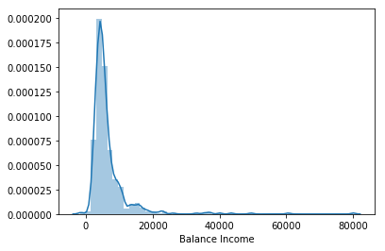
Feature Engineering
The plot of EMI and Balance Income
From the EMI and Balance income plots we can infer that the mean of both are almost near to zero and both of them have a positive skewness which will not affect our calculations.

Slide 19
Feature Engineering
Recursive feature elimination:
Recursive feature elimination works by recursively removing attributes and building a model on those attributes that remain. It uses the model accuracy to identify the which attributes contributes the most to predicting the target attributes
From Recursive feature elimination, we know that Credit History, property area, Married_No, Education _Not_Graduate are the most important features.
Tree based method:
Decision tree based methods can be used to find out the best features based on the information gain and Gini index
From univariate selection, we know that credit history is the most important features followed by the EMI, total amount and balance income.

Slide 20
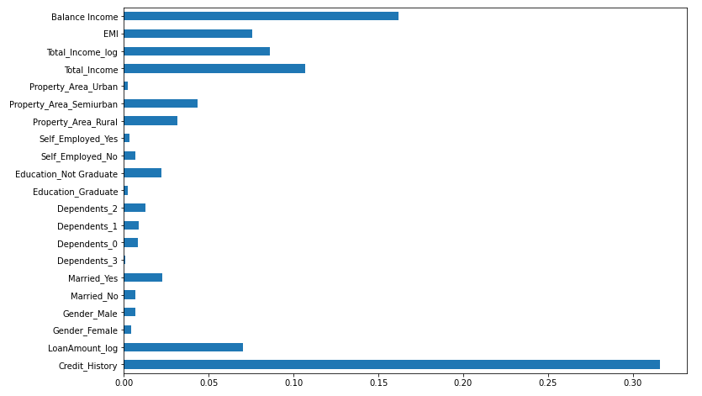
Feature Engineering
Credit History is the most important feature followed by Balance Income, Total Income, EMI.

Slide 21
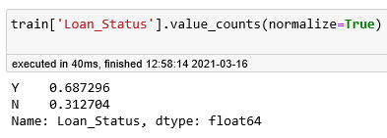
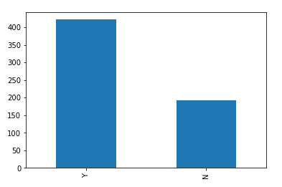
Handling the imbalanced datasets
Imbalanced dataset is a dataset where the majority class is much larger than the minority class.
The loan of 422(around 69%) people out of 614 were approved so the target variable (loan status) is imbalanced. The below graph represents the imbalance of the dataset.
We are using Resampling technique to handle the imbalanced dataset.
Resampling changes the dataset into a more balanced one by adding instances to the minority class or deleting ones from the majority class.
Resampling technique has two main methods I.e Over sampling and Under sampling.

Slide 22
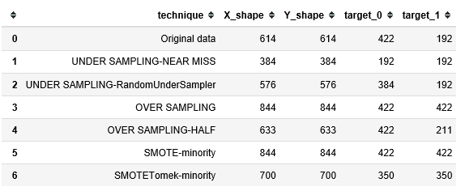
Handling the imbalanced data
Over sampling: This method adds copies of instances from the minority class to obtain a balanced dataset.
Under sampling: this method simply delete instances from the majority class in different ways to obtain a balanced dataset.
The below table shows data's from various re-sampling techniques to handle the class imbalance in a dataset and we have selected synthetic minority oversampling technique(SMOTE) to handle the imbalance because it will reduce the problem of overfitting and loss of useful information.

Slide 23
Model Validation Technique:
In this project, we are using Stratified K-fold cross validation technique because it is beeter approach when dealing with both bias and variance.
Stratification is the process of reaaranging the data so as to ensure that each fold is a good repesentative of the whole.
It works by splitting the dataset into K-parts(K=5 or K=10). Each split of the data is called a fold. The alogirthm is trained on K-1 folds with one held back and tested on the held back fold. This is repeated so that each fold of the dataset is given a chance to be the held back test set.
In stratified K-fold cross validation, it uses stratified sampling Instead of random sampling.

Slide 24
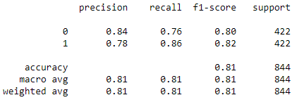
Model Building
Logistic Regression:
Logistic regression is a statistical model that in its basic form uses a logistic function to model a binary dependent variable.
A Logistic regression model predicts a dependent data variable by analyzing the relastionship betwwen one or more existing independent variables.
By using train_test_split validation technique , we got

Slide 25
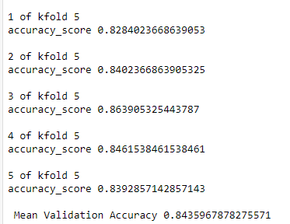
Model Building-Logistic Regression
Logistic Regression using stratified k-folds cross-validation:
The mean validation accuracy:

Slide 26
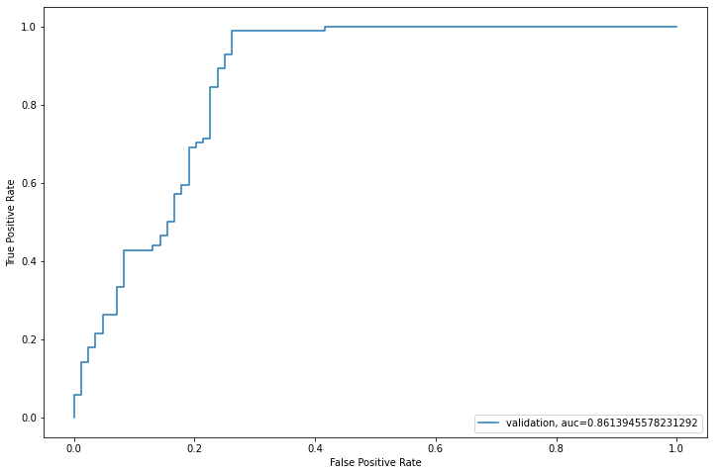
Model Building: Logistic Regression
Receiver Operating Characteristics curve(ROC):
From ROC Curve, Area Under the Curve value = 0.8613

Slide 27
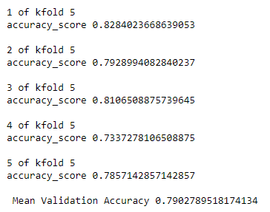
Model Building-Decision Tree
Decision Tree using stratified k-folds cross-validation:
The mean validation accuracy:

Slide 28
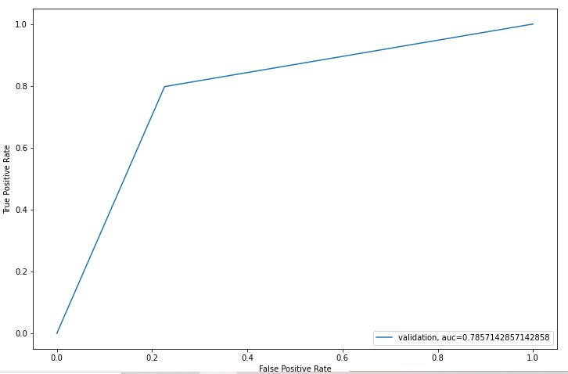
Model Building-Decision Tree
Receiver Operating Characteristics curve(ROC):
From ROC Curve, Area Under the Curve value = 0.7857

Slide 29
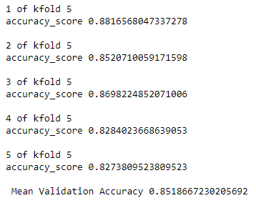
Model Building-Random forest
Random forest using stratified k-folds cross-validation:
The mean validation accuracy:

Slide 30
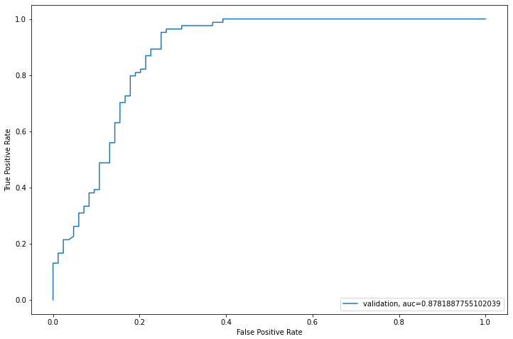
Model Building-Random forest
Receiver Operating Characteristics curve(ROC):
From ROC Curve, Area Under the Curve value = 0.8781

Slide 31
Model Building-XGBoost
XGBoost using stratified k-folds cross-validation:
The mean validation accuracy:
1 of kfold 5
accuracy_score 0.8284023668639053
2 of kfold 5
accuracy_score 0.834319526627219
3 of kfold 5 accuracy_score 0.8461538461538461 4 of kfold 5
accuracy_score 0.8165680473372781 5 of kfold 5 accuracy_score 0.8154761904761905 Mean Validation Accuracy 0.8281839954916878

Slide 32
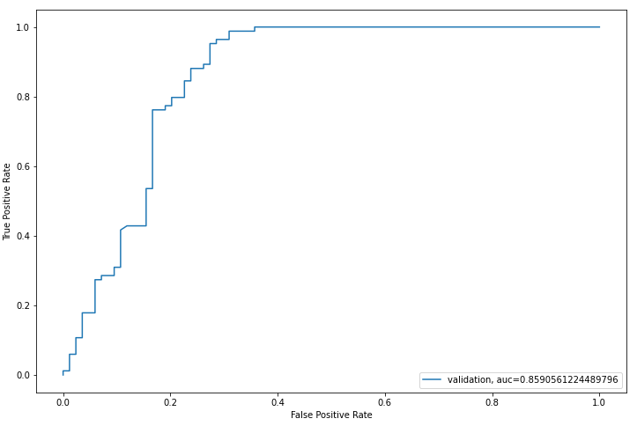
Model Building-XGBoost
Receiver Operating Characteristics curve(ROC):
From ROC Curve, Area Under the Curve value = 0.8590

Slide 33
Model Building-summary
The below table shows comparison of different models based on their mean validation accuracy,Log loss and AUC value.
We finalized Random Forest Classifier model for deployment because it gives better accuracy and AUC value.
MODELS | Mean Validation Accuracy | AUC Value | Log Loss
Logistic Regression | 0.8435 | 0.8613 | 5.345
Random Forest | 0.8518 | 0.8781 | 6.168
Decision Tree | 0.7902 | 0.7857 | 7.195
XG-Boost | 0.8281 | 0.8590 | 7.812

Slide 34
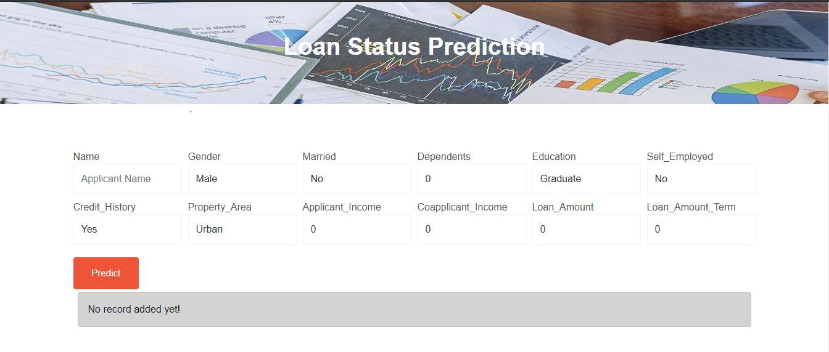
Deployment
Saved model using sklearn joblib and used flask, bootstrap and Heroku to deploy the app
Link for the deployed model
https://loan-prediction-app2.herokuapp.com

Slide 35
Thank You

